Slide 1
The Big Five Presents: Lockdown/Barricade
Think-on-Your-Feet Peet and the Slimeville Monsters
4th-5th Grades
2023-2024 School Year
Curriculum/Implementation Deck

Slide 2
About This Deck
The contents of this deck accompany The Big Five book, Think-on-Your-Feet Peet and the Slimeville Monsters.
The class should read the book aloud.
The question prompts were created to use as discussion questions while reading the book.
The definitions for the vocabulary words and understanding of concepts.
Teachers may use and customize the content of this deck as appropriate.

Slide 3
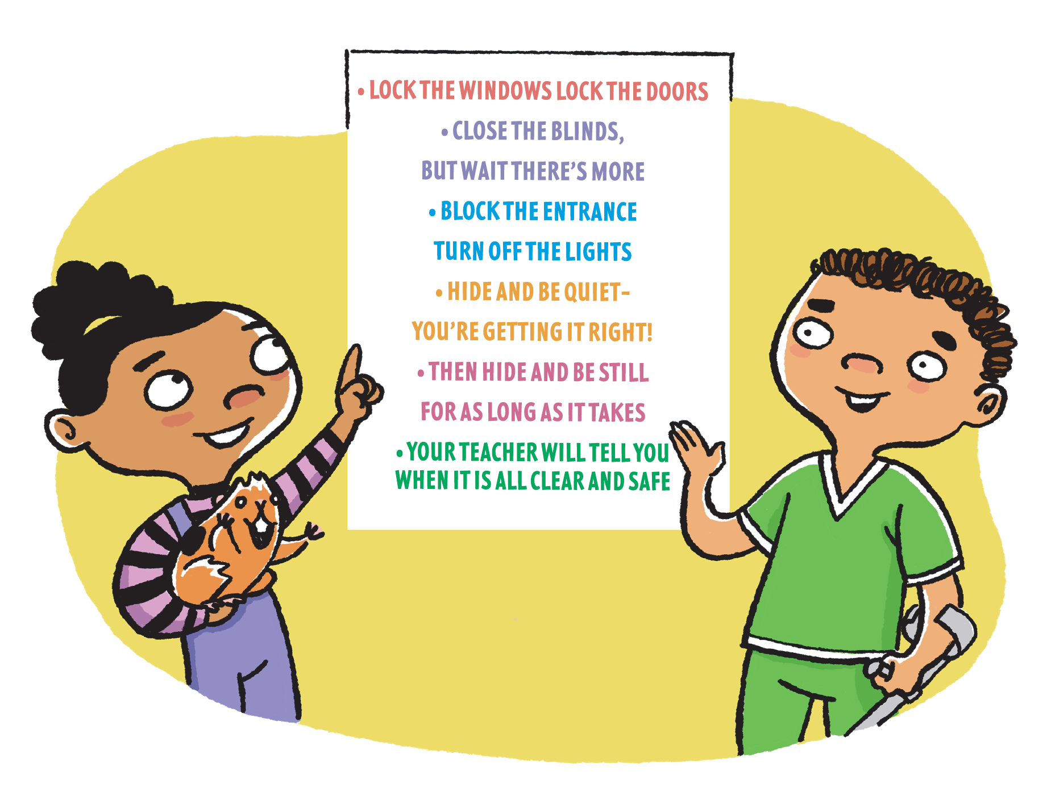
Peet and their classmates reference a poster that tells them what to do.
Have you ever noticed a poster in your classroom?

Slide 4
The Big Five
Immediate Action Response
Shelter in Place
Drop, Cover and Hold On
Secure Campus
Lockdown/Barricade
Evacuation
Notes:
Briefly review the Big Five Immediate Action Responses
Remind students that when we need to respond, the teacher will guide them and help them know what to do.
Throughout the year, you might remember that we do Drills, these drills help us practice the Big Five
Practicing helps us remember what to do
Reading this book and talking about this helps us learn how to Lockdown/Barricade

Slide 5
Notes:
When an intruder is on campus

Slide 6
Vocabulary Words
Intruder: A person who enters a building, grounds, etc. without permission
Lockdown: A security measure taken during an emergency to prevent people from leaving or entering a building or other location
Barricade: A temporary wall or fence across a road, door, etc. that prevents people from going through

Slide 7
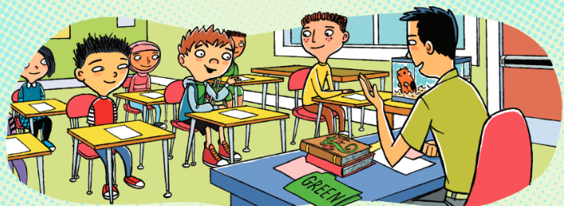
Think on Your Feet
to be able react to an event quickly and make a decision
as to how to handle a situation
Notes:
Thinking on Your Feet gives you multiple options depending on where you are on campus, who is around you, and what you feel you can do in that moment.

Slide 8
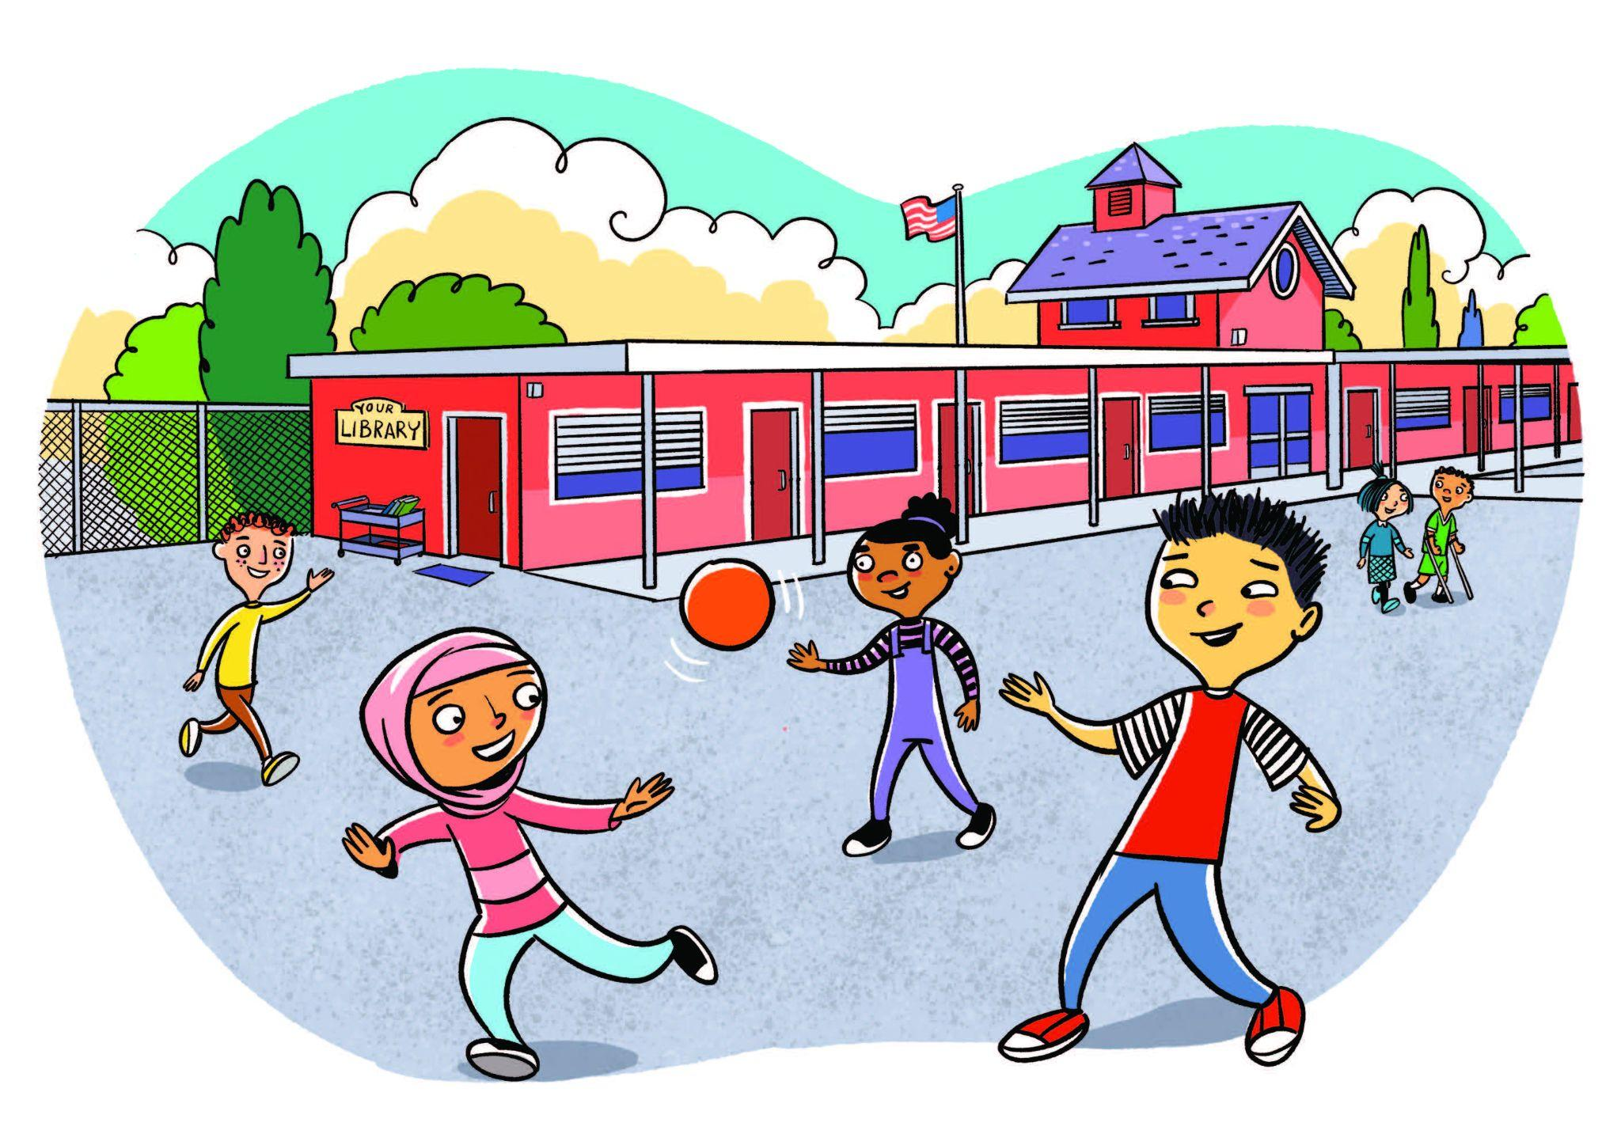
Escape/Get Off Campus
Sometimes it is safest to get off campus.
Where could you go if you needed to run off campus?
Think of a few choices!
Notes:
Sometimes, getting off campus may be the safest thing to do. If you can, safely run off campus and find a safe location to go to.
Call 911 immediately. Let the police know where you are and what is happening at your school.
Stay Put and wait for help to arrive

Slide 9
Lockdown/Barricade
The students helped Mr. Lee lockdown and barricade the classroom.
How could you help your teacher Lockdown/Barricade your classroom?
Notes:
If you can’t get off campus, find a room that you can hide in. Once inside, lock the door/windows and build a barricade.
Remain still and quiet; turn off lights and silence cell phones
If unable to find cover inside a secure room, quickly seek out a hiding place on campus
Stay Put and wait for help to arrive.
The Police and Fire Department will come and unlock the doors, just like in the book. You don’t need to open the door for them.

Slide 10
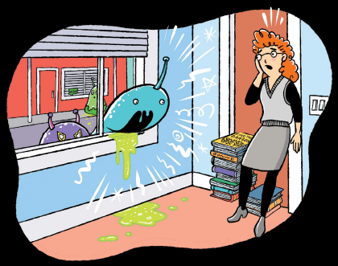
Protect or Defend
Lastly, you may need to protect or defend yourself.
Listen to your teacher
Use objects around you to protect or defend yourself
Think on Your Feet to try to get away
Notes:
If confronted by an intruder, consider fighting back, use items around you to defend and protect yourself, disarm/distract the intruder, so you can get away.

Slide 11
Most Importantly
Think on Your Feet
Be aware of your surroundings
Listen to your teacher or school staff
Work as a team and help each other
Being prepared helps us stay safe
Notes:
After reviewing the book and slide deck, feel free to move to the Activity, discussing different scenarios in order to deepen their understanding of the Think on Your Feet concept.
After the Activity, engage them in a movement break and then go back to learning/instruction of coursework.

